Slide 1

Optimizing Marketing Strategies – Improving Operational Efficiency and Revenue generation
Case Study Group: Ankit Mathur, Lakshmi Sagar, Rakesh Kumar Sahoo, Rohit Vashishth
Group Name: ALRR0625

Slide 2

Agenda
1
Objective & Goals
2
Findings
3
Background
4
Insights and Recommendations
5
Recommendations
6
Appendix

Slide 3
Overview & Objectives
Business Overview
Namma Yatri plays a pivotal role in Bengaluru’s urban transport network. Operating in a dynamic environment, the company must continuously adapt to shifting demand patterns, optimize ride allocation, and maintain profitability — all while delivering a superior customer experience. To support this, Namma Yatri aims to deepen its understanding of ride patterns, customer behavior, and operational bottlenecks.
Objectives
The objective is to uncover insights that can guide decisions to improve service efficiency, maximize revenue, and enhance customer satisfaction through:
Identifying peak demand patterns and trends
Uncovering factors influencing cancellations and driver performance
Optimizing payment methods and trip durations
Improving resource allocation and marketing strategies

Slide 4
Background – Initial observations
Background
Peak demand patterns and trends – Afternoon and Forenoon
Cancellation rate stands at 23%
Driver performance – 88%
Payment method – Digital payments 74%
Low Conversion rate – 45%

Slide 5
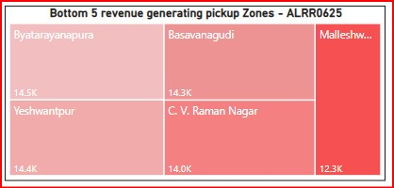
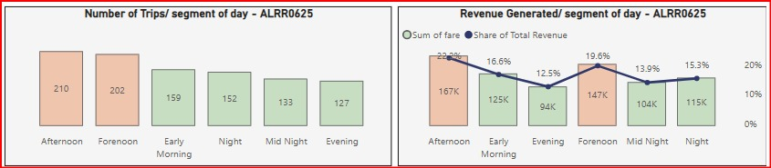
42% of revenue is generated during business hours
Insights
Maximum trips & revenue are between 7 AM to 5 PM
Time slot Midnight to 1 AM has the highest hourly revenue – 45K
Bottom 5 pickup zones contribute only 9.3% (69.5K) of total revenue

Slide 6
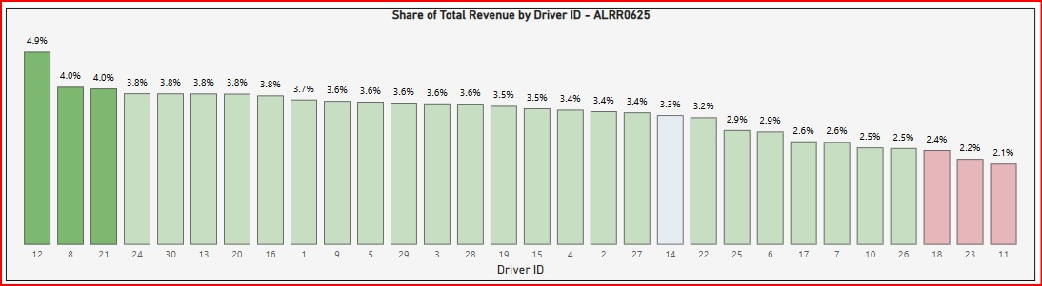
33% of our drivers are performing below average
Insights
Average Revenue per driver – 3.3% (25K)
Drivers below average revenue – 33% (10)
Top 3 drivers – 12, 8 and 21
Bottom 3 drivers – 18, 23 and 11

Slide 7
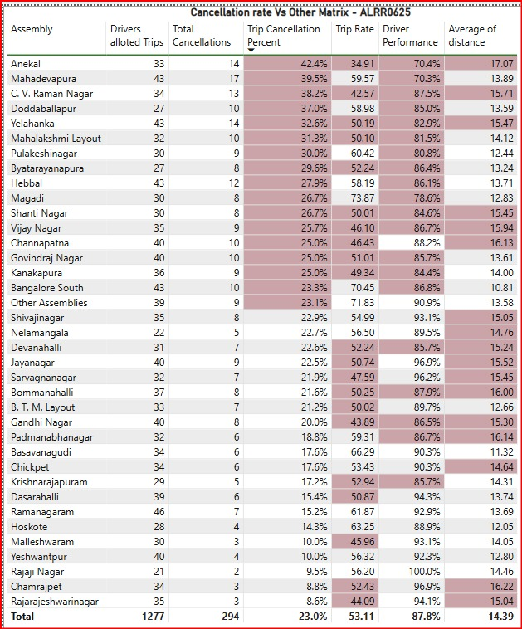
Nearly half of the locations exceed the average cancellation rate
Insights
46% (17) of locations have cancellation rate above average (23%). Following locations show a trend of low Driver performance (more cancellations from Drivers) because of low Fair per KM w.r.t. high distance:
Anekal – 42.4%
C V Raman Nagar – 38.2%
Yelahanka – 32.6%
Shanti Nagar – 26.7%
Vijayanagar – 25.7%
Channapatna – 25%

Slide 8
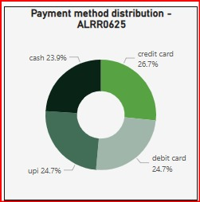
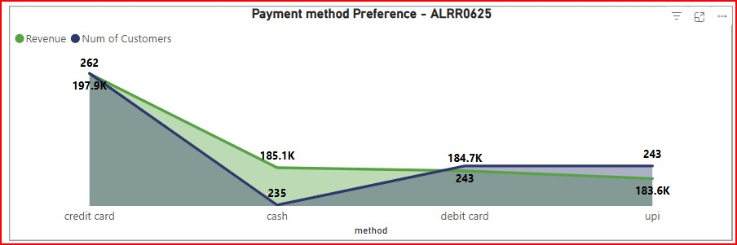
Encourage customers to opt for Digital payment methods
Insights
Insights
Digital transactions – 76% (Credit Card > Debit Card > UPI) outperformed Cash transactions – 24%.
Unusual revenue distribution — 185.1K of revenue for 235 rides suggests that while fewer customers use cash, their trips tend to be high-value rides

Slide 9
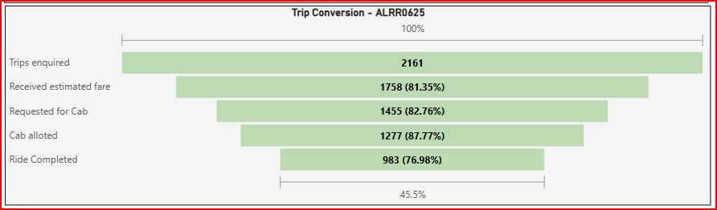
Recommendations
Revenue generation
Offer targeted discounts or cashbacks for rides during Early Morning, Evening, Night, and Midnight windows.
Time slots between 4 PM and 8 PM show higher average fares but generate relatively lower revenue indicating underutilization from both operational and marketing standpoints
Drivers’ performance
Driver incentivization program to improve performance
Rides cancellation
Addressing driver and customer cancellations can improve ride completion to 59%.
Payment methods
Encourage Digital Alternatives for High-Value Rides- Offering exclusive discounts or smoother checkout for high-value transactions on Digital payment methods
Ride conversion rate
Reducing wait-times by better driver allocation can further improve the completion rate to 67%
Experiment with A/B tests for ride suggestion algorithms and booking flows to increase conversions to 80%

Slide 10
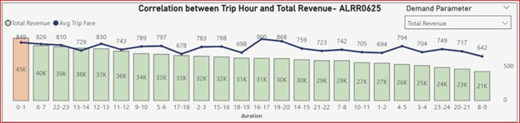
Appendix – Revenue Optimization
Late night and early morning rides had higher average fares due to longer trips or surge pricing.
Revenue spikes are observed at non-linear intervals, such as:
Midnight (0–1 AM)
Morning (6–7 AM)
Late evening (10–11 PM)
This implies that ride fare is driven more by specific travel behaviors (e.g., airport transfers, commuting patterns, late-night surges) rather than just the hour of the day. Refer figure-6

Slide 11
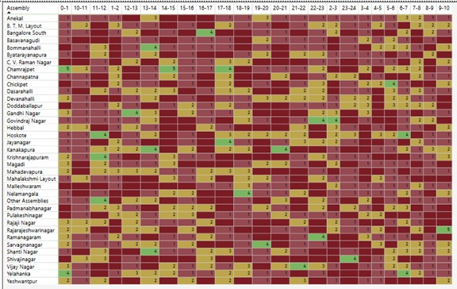
Appendix – Location Vs. Duration (Trip optimization)
The heatmap above displays trip volume by pickup zone (rows) and time slot (columns).
Green shades represent higher numbers of rides and Red shades represent zero or less numbers of rides. Amber is moderate number of rides.
Peak ride periods differ by zone. Resource allocation can be optimized by mapping peak hours with zones.

